Slide 1
SINGAPORE TRAVEL PLANNER
Group 3 Project Proposal

Slide 2
Goal :
Help the users plan the travel itinerary in Singapore according to their preferences
By Using Data retrieved from Foursquare's API for all sections

Slide 3
Inputs from the User:
Time to be spent for sight-seeing(1day =16 hours)
Where will the user be staying ( Starting point)
User preferences (Free text)

Slide 4
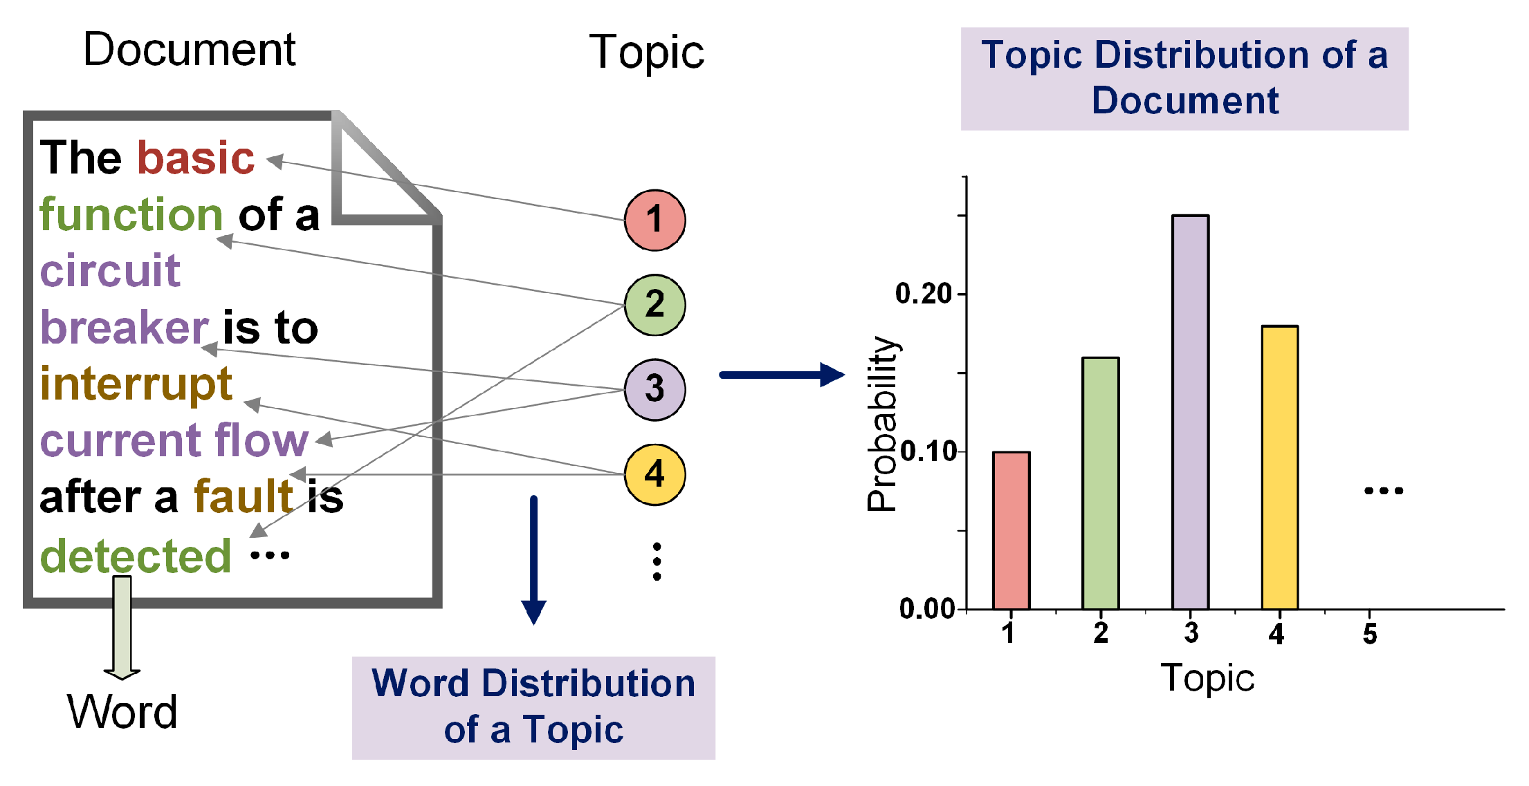
Methodology :
Web Crawling – Crawl the data in Foursquare for different places in Singapore and store in the tables namely:
Venue containing Unique ID, Venue, Description and Rating
Tips containing the Venue ID and comments
Comments Score using the Sentiment Analysis
2. Use Latent Dirichlet allocation (LDA) to model the topics and the composition of topics of each Venue. When a user provides Preferences, we can take the preferences as a single document and classify it with the LDA model.

Slide 5
3. Sort by Popularity : From the list of venues fetched from LDA model sort the venues depending on the Sentiment score.
4. Shortest Paths : Build the algorithm to determine the shortest path from point to point. Path weights are determined using the Haversine formula.
5. WEB USER INTERFACE Development: Build the Web Application and integrate with the above interface

Slide 6


